Slide 1
Software Engineering COMP 201
Teaching staff
Sebastian Coope
Ashton Building, Room G.18
E-mail: coopes@liverpool.ac.uk
Mr Henry Forbes
H.J.Forbes@liverpool.ac.uk
Ashton Building, Room G.17
See Canvas for all notes
Lecture 1 – Module Introduction

Slide 2
This module
Is NOT focused largely on programming or programming technology (APIs etc), we do however look at some coding issues…. (e.g. coupling, cohesion and code structure)
Why focus away from coding…
This is covered in other modules
System failures are rarely about lack of knowledge of programming language or incorrect use of API or programming language
Failures are very often due to
Wrong or missing requirements (missing or wrong features)
Poor software design (software is inflexible and fragile)
Problems with testing (bugs)
Weak risk analysis and/or project management (project overrun)
Problem with process (or lack of process) (overrun, cancelled)

Slide 3
What is SOFTWARE ENGINEERING
ENGINEERING
Making stuff
But
In a structured and disciplined manner!
Using tried and tested approaches
SOFTWARE
Code (instructions)
Data designs (data base schemas)
AI training models

Slide 4
Why Software Engineering?
Software development is hard !
Important to distinguish :
“easy” systems (one developer, one user, experimental use only)
“hard” systems (multiple developers, multiple users, products)
Experience with “easy” systems is misleading
Single person techniques do not scale up
Analogy with bridge building:
Over a stream = easy, one person job
Over River Severn … ? (the techniques do not scale)

Slide 5
Why Software Engineering ?
The problem is complexity
There are many sources of complexity, but size is key:
The Linux kernel contains >13 million lines of code
Windows XP contains >40 million lines of code
Software engineering is about managing this complexity.

Slide 6
Why Software Engineering ?
Software failure can be very serious
Software controls safety critical systems
Software protects sensitive data
Software is involved in systems which handle money
Software Engineering has to
Produce software which has a very low chance of faulting
Be able to demonstrate/proof that software has very low chance of fault
Testing or program proving

Slide 7
Software engineering tasks
Define requirements
What should it do?
Design the product
Design how the product should look and be constructed
UI design, software module design, data design (what data?)
Implement and test
Coding, testing and validation
Managing the process
Software project management

Slide 8
Teaching Method
Lectures 3 hours/week Streams also on Canvas
1 Hour/week seminar, tutorial
Practical work (3 Assignments)
----------------------- Course Assessment ----------------------
A two-hour examination: 60%
Coursework: 40%
-----------------------------------------------------------------------

Slide 9
COMP201 Practical
Practical slots: (from WEEK THREE)
1 hour/week
Use these sessions to do your coursework
COMP 201 Assignments
Assignment 1 – Part 1 Requirements Engineering (20%)
Use case analysis, non-functional requirements
Assignment 2 – Part 1 Design and implementation (5%)
Assignment 2 – Part 2 Modelling with UML (15%)

Slide 10
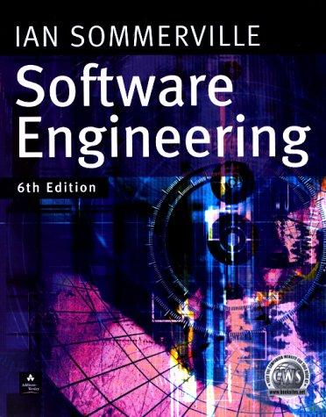

Recommended Course Textbooks
I. Sommerville (2001,2004, 2007)
Software Engineering 6th ,7th or 8th Edition,
Addison-Wesley, Harlow, Essex, UK
P. Stevens with R. Pooley (2000),
Using UML: Software Engineering with Objects and Components, 1st or 2nd Edition,
Addison-Wesley, Harlow, Essex, UK

Slide 11
Outline Syllabus
Introduction to Software Engineering
Software models
Software requirements
Software Design and Implementation
UML (Unified Modeling Language)
Software verification, validation and testing
Management of Software Projects & Cost Estimation

Slide 12
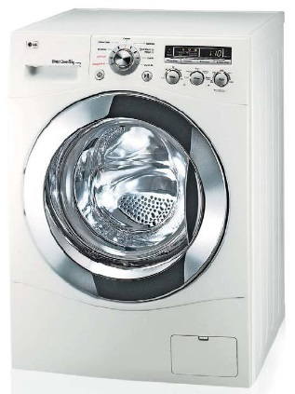
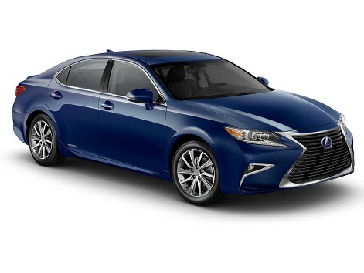


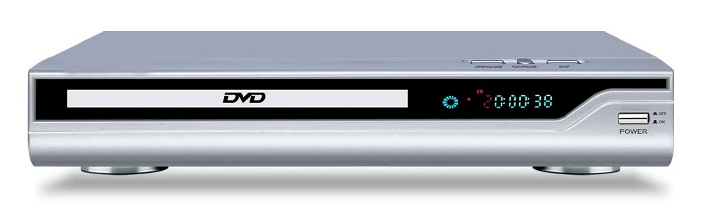
Software

Slide 13
Software Engineering
The economies of ALL developed nations are dependent on software.
More and more systems are software controlled
Software engineering is concerned with theories, methods and tools for professional software development.
Some software can be classified as critical (air traffic control, medical software, nuclear reactor control software..).

Slide 14
FAQs about Software Engineering
What is:
software?
a software process?
software engineering?
a software process model?

Slide 15
Software and machine learning
For machine learning AI type models the software consists of
A network with internal state (typically a neural net)
The network is trained
The training as well as the net itself is the software
Implications
The model is extremely complex and hard to understand explicitly
The determinations of the network are probabilistic and therefore can be wrong

Slide 16



Examples of Software products
Programs
Games, servers, databases, languages, office applications
Crypto coin wallets
Apps, embedded systems
Documents
User manuals
Content
Designs and specifications

Slide 17
What is Software Engineering?
Software engineering is an engineering discipline which is concerned with all aspects of software production
Software engineers should
adopt a systematic and organised approach to their work
use appropriate tools and techniques depending on
the problem to be solved,
the development constraints and
the resources available

Slide 18
Good Software Engineers
Tend to
Not keep making the SAME mistakes again and again
(so document your mistakes)
Use tried and tested approaches
Communicate well with others
Work well in teams
Document their work
Spend a lot of time testing
Produce code which can be fixed/modified and understood easily by others
Can predict their own productivity
Being a good software engineer
Is not very easy!

Slide 19
Major Software Failures
Colonial Pipeline’s costly ransomware attack 2021
Shut down fuel pipe line to Eastern US
Tesla recalls almost 12,000 vehicles November 2021
Log4j software bug leaves millions of web servers vulnerable Dec 2021
Therac-25 (1985-1987) : six people overexposed during treatments for cancer
Taurus (1993) : the planned automatic transaction settlement system for London Stock Exchange cancelled after five years of development
Ariane 5 (1996) : rocket exploded soon after its launch due error conversion (16 floating point into 16-bit integer leading to an exception)
The Mars Climate Orbiter : assumed to be lost by NASA officials (1999): different measurement systems (Imperial and metric)

Slide 20
Recent failure…
Mon, 22nd Jul 2024 Microsoft blue screen of death
Widespread outage caused by a faulty CrowdStrike update, Falcon malware check
Azure cloud service failure
We currently estimate that CrowdStrike’s update affected 8.5 million Windows devices (< 1 percent)
Many medical services in UK affected, TV stations, airlines
Problems with
Single point of failure (monopoly of service), failure to test

Slide 21
What is a Software Process?
A Software Process is a set of activities whose goal is the development or evolution of software
Fundamental activities in all software processes are:
Specification - what the system should do and its development constraints
Development - production of the software system (design and implementation)
Validation - checking that the software is what the customer wants
Evolution - changing the software in response to changing demands

Slide 22
What are the Attributes of Good Software?
The software should deliver the required functionality and performance to the user and should be maintainable, dependable, efficient and usable.
Maintainability
Software must (easily) evolvable to meet changing needs
Dependability
Software must be trustworthy (work with all data)
Efficiency
Software should not make wasteful use of system resources
Usability
Software must be usable by the users for which it was designed

Slide 23
Professional and Ethical Responsibility
Software engineering involves wider responsibilities than simply the application of technical skills.
Software engineers must behave in an honest and ethically responsible way if they are to be respected as professionals.
Ethical behaviour is more than simply upholding the law.

Slide 24
Issues of Professional Responsibility
Confidentiality
Engineers should normally respect the confidentiality of their employers or clients even without a formal confidentiality agreement.
Competence
Engineers should not misrepresent their level of competence. They should not knowingly accept work which is beyond their competence.

Slide 25
Issues of Professional Responsibility
Intellectual property rights
Engineers should be careful to ensure that the intellectual property of employers and clients is protected and know the local laws governing IP.
Computer misuse
Software engineers should not use their technical skills to misuse other people’s computers.

Slide 26
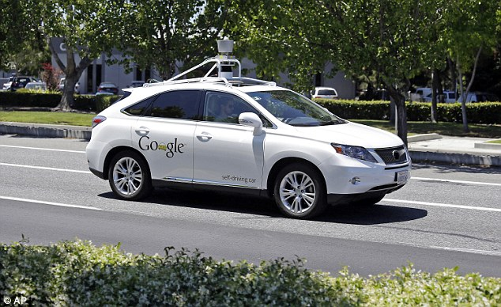
Ethics and software engineering

Slide 27
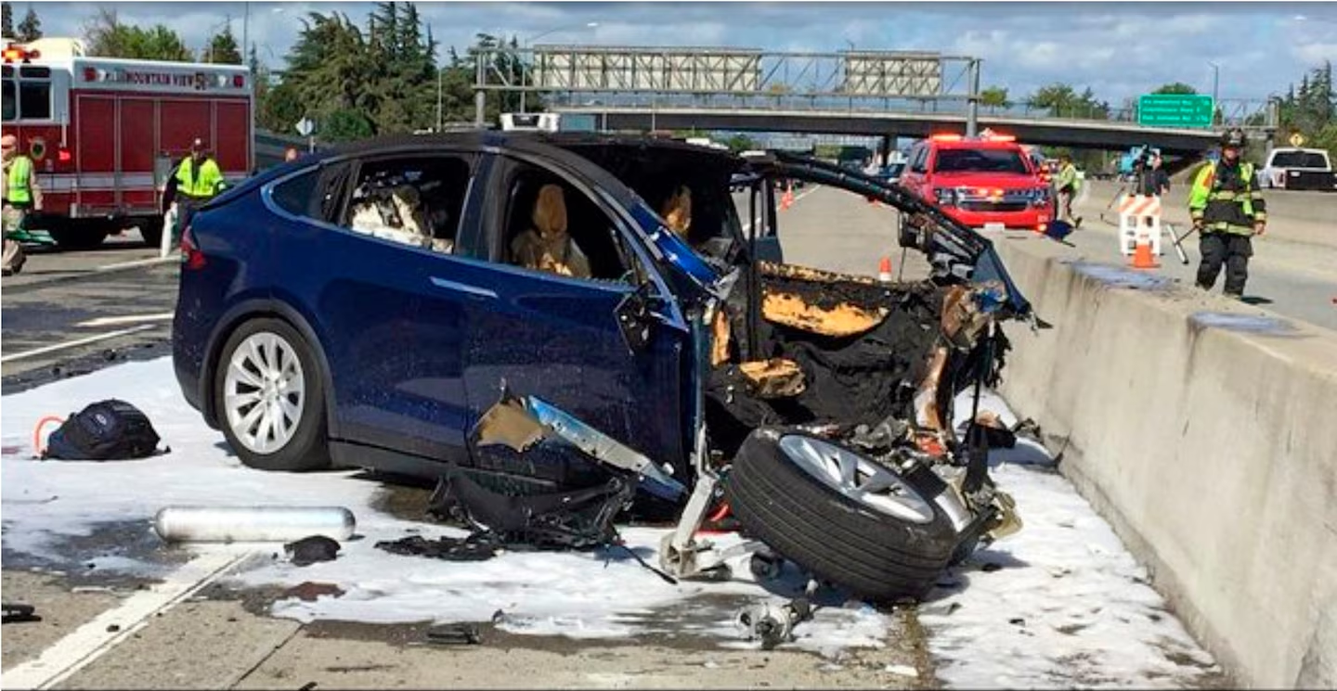
Tesla crashed due to software issues
The Washington Post analyzed NHTSA's numbers and found that Autopilot was involved in 736 crashes since 2019, including 17 fatalities

Slide 28
Ethics for the 21st Century
What if a robot you design the AI software for
Hurts (kills) someone, causes damage
Who is responsible?
You?
The owner of the robot?
The robot?
https://en.wikipedia.org/wiki/Self-driving_car_liability
What if a robot you design and produce, designs and produces another robot? Etc. etc.

Slide 29
Lecture Key Points
We have seen the reasons for requiring solid software engineering principles in modern systems
Software engineering is an engineering discipline concerned with all aspects of software production.
Software products consist of developed programs and their associated documentation with several essential product attributes such as maintainability, dependability, efficiency and acceptability.
Software Engineers have responsibilities to the engineering profession and society and should not simply be concerned with technical issues.

